Slide 1
Conclusion
Data 100
Slides by John DeNero

Slide 2
Announcements

Slide 3
Project 3 Review: PCA

Slide 4
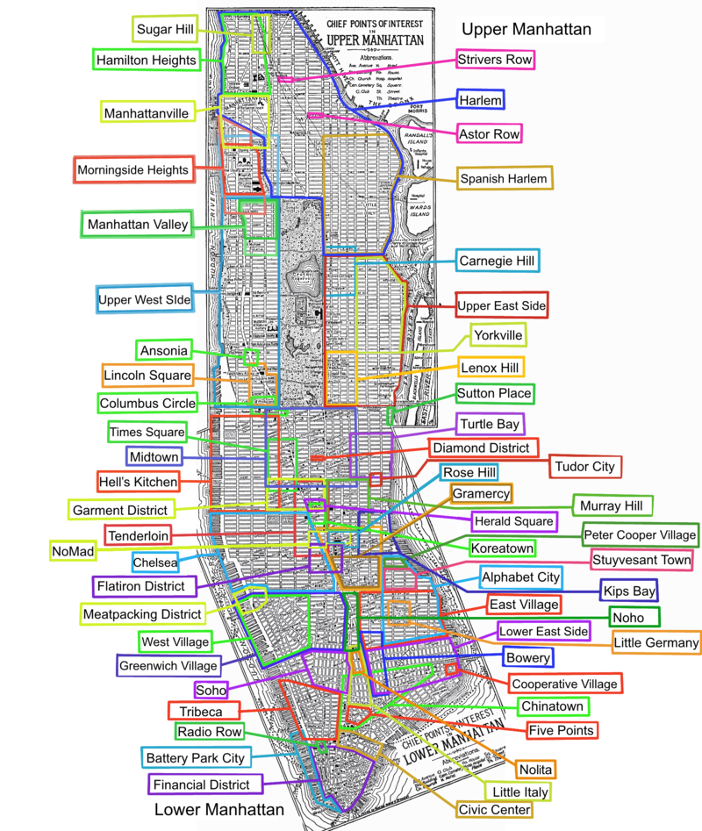
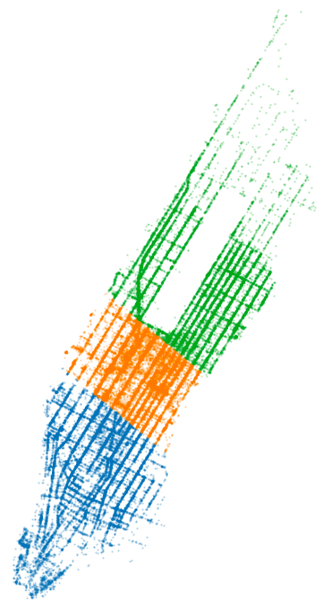
PCA Application: Dividing Manhattan Into Regions
(Demo)
Goal: Automatically partition the geography of Manhattan into distinct regions.
Approach: Reduce to one dimension and partition the values.
PCA: Use first principal component as the one dimension used for partitioning into regions.

Slide 5
Feature Engineering in Prediction
(Demo)
There are two primary uses of model fitting:
Analysis: What parameters fit the whole dataset?
Prediction: How do parameters fit to a training set perform on a test set?
In prediction, an instance should have the same features whether it’s in the training set or the test set.
But all data-driven features should be computed only on the training instances.
E.g., let’s say a dataset has train: [4, 2, 6, 4]; test: [8, 6]
To express this quantity in centered units (zero mean; original spread), do you:
Subtract 4 from all original values.
Subtract 5 from all original values.
Subtract 4 from all train values and 7 from all test values.

Slide 6
Feature Engineering Choices
(Demo)
In a linear (or logistic) model, feature engineering can improve performance if the association between X and y is not linear (or logistic).
Data transformations for quantitative covariates:
Higher-degree polynomials: [X₁, X₁X₁]
Interaction terms: [X₁, X₂, X₁X₂]
Function application: [X₁, log(X₁)]
Binning values: qcut(X₁, n)
Searching over all possible data transformations can be effective, but leads to overfitting, so the data transformation should be selected using held-out data.

Slide 7
Survey

Slide 8
What’s Next?

Slide 9
Machine Learning Courses
CS 189 and Stat 154:
Further analysis of linear and logistic regression models
Other classification methods and loss functions
Extension of logistic regression to multi-layer neural networks
Clustering and dimensionality reduction
CS 182:
Extension of logistic regression to multi-layer neural networks
Applications of neural networks
Data representation issues that arise with neural networks
Alternatives to gradient descent

Slide 10
Data 102
A direct extension of the inference and interpretation topics in Data 100:
Probabilistic interpretation of logistic regression
Confidence intervals and credible intervals
Bayesian and frequentist approaches from a data science perspective
Bandit problems: how do you find the best layout for your website?
Privacy problems: how do you train a classifier on sensitive data?
Data problems: how do you account for divergent train and test sets?
And much more!

Slide 11
Applying Data Science
Find datasets and practice! E.g., https://toolbox.google.com/datasetsearch
Explain what you discover to someone else who took this course.
Work with others who have more/different experience
Check your work (especially when you’re doing something important)
Let us know what you do next!

Slide 12
The End

